Slide 1

Database Lab 11 Constraints Addendum
Dr. Jefferson Fong

Slide 2
Slide 3
The file uic_without_foreign_keys.sql is the same as uic.sql (the solution to Lab07) except the uic_without_foreign_keys.sql does not have foreign keys.
Open the two files and compare; look for “foreign” in the files.
Create the database uic_without_foreign_keys. Can do this 2 ways:
(A) Use the SQL in uic_without_foreign_keys.sql.
Copy all the text in uic_without_foreign_keys.sql.
Notice near the top, we have
CREATE DATABASE IF NOT EXISTS `uic_without_foreign_keys` …
You have done something similar in Lab 6.
In XAMPP, open a new database
Paste the query in the SQL tab and run it. The database should appear in the navigation tab at the left hand side of XAMPP.
(B) Create the database manually. (See next slide.)

Slide 3
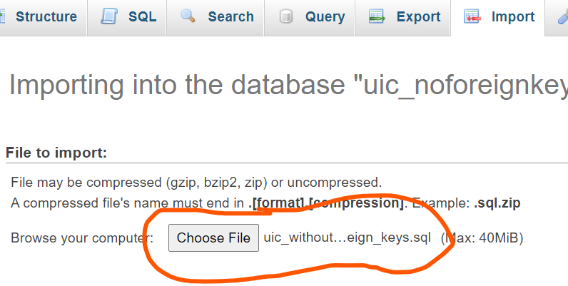
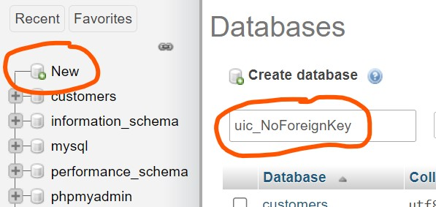
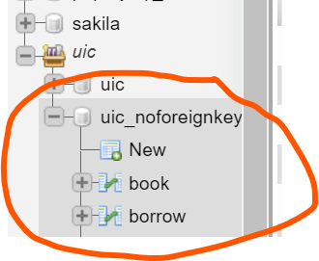
1. Create a database uic_NoForeignKey.
Recall Lab 1
2. Import the file uic_without_foreign_keys.sql.
3. Do this week’s examples and exercises in the uic_noforeignkey DB.

Slide 4

Slide 5
You might need to use the back tic ` in some version of MySQL:
Slide 6
In some version of MySQL, you might
Ignore the red x warning.
Put in back tick ` in gpa_domain.

Slide 5
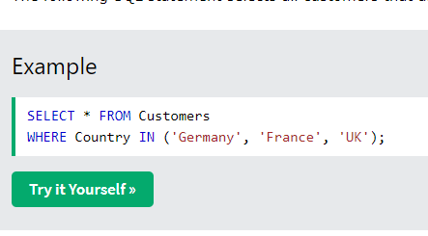
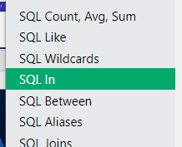
Exercise 1: (c.f. check gpa example in Slide 6)
ALTER TABLE enroll
ADD CONSTRAINT grade_domain
CHECK (grade IN ('A','A-','B+','B','B-','C+','C','C-','D','F'));
See W3 Schools SQL to find the syntax for IN (and other things).
Exercise 3 has a lot of tables. Do a few to convince yourself you know how to add foreign keys.
For more examples, see Lab 7 solution (uic.sql); look for “foreign key” there.

Slide 6


Slide 7
Heads-up
Presentations are scheduled on Thu 12 Dec and Mon 16 Dec.
My experience is that students don’t want to present on Thu 12 Dec.
So we have presentation make-up date on Sun 15 Dec instead of Thu 12 Dec.
Sign up for time slots next week.
Assignment 3 will be released; due date Dec ____
Final Exam will be on 27 Dec 9:30-12:30, T7-203.

